Slide 1
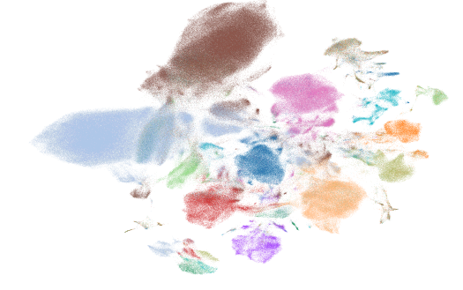


Generating a Consensus Pituitary Atlas
Bence Kövér, Hui-Chun Lu, Cynthia Andoniadou
Londonomics meeting – Sep 2nd, 2025

Slide 2
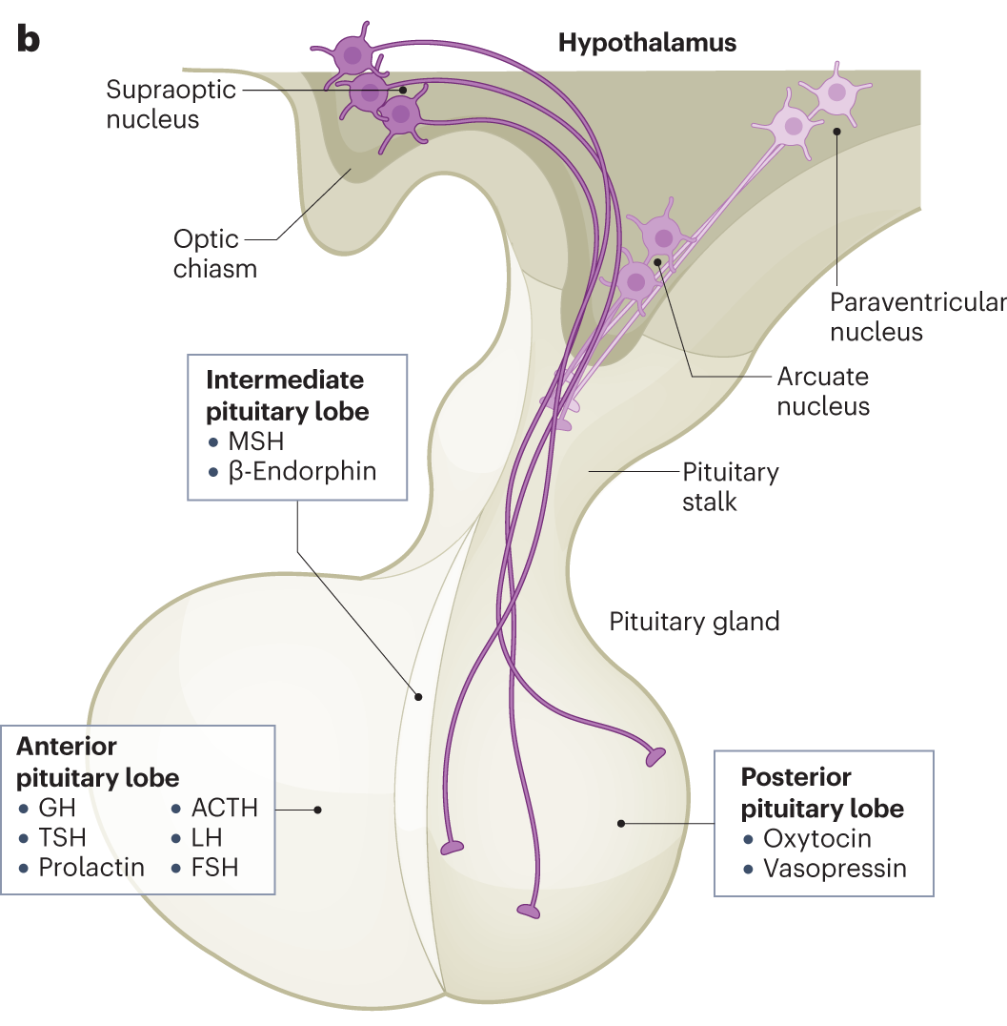
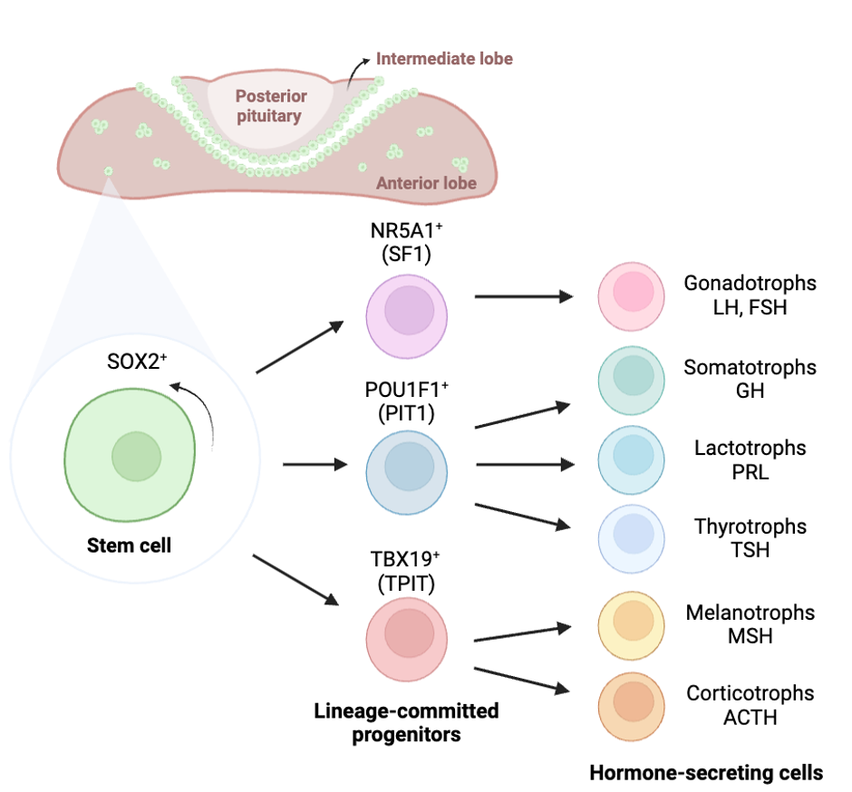
Pituitary gland – a central endocrine regulator
Contributing to various processes:
Fertility
Growth
Metabolism
Stress
…
c
Human
Clinical relevance:
Hypopituitarism: Hormone deficiency (congenital or acquired) - Kim et al. (2015); Martinez-Mayer et al. (2024)
Tumors: Adenomas, Craniopharyngiomas Daly et al. (2020); Melmed et al. (2022)
Potential for future improvement:
Regenerative approaches
Cell therapies
Earlier diagnosis
Improved patient stratification, accurate prognosis
Perez Millan et al. (2024)
Mouse
Need
Better understanding of cell types / states
and how they came to be - cell fates

Slide 3
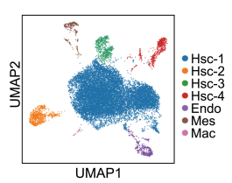
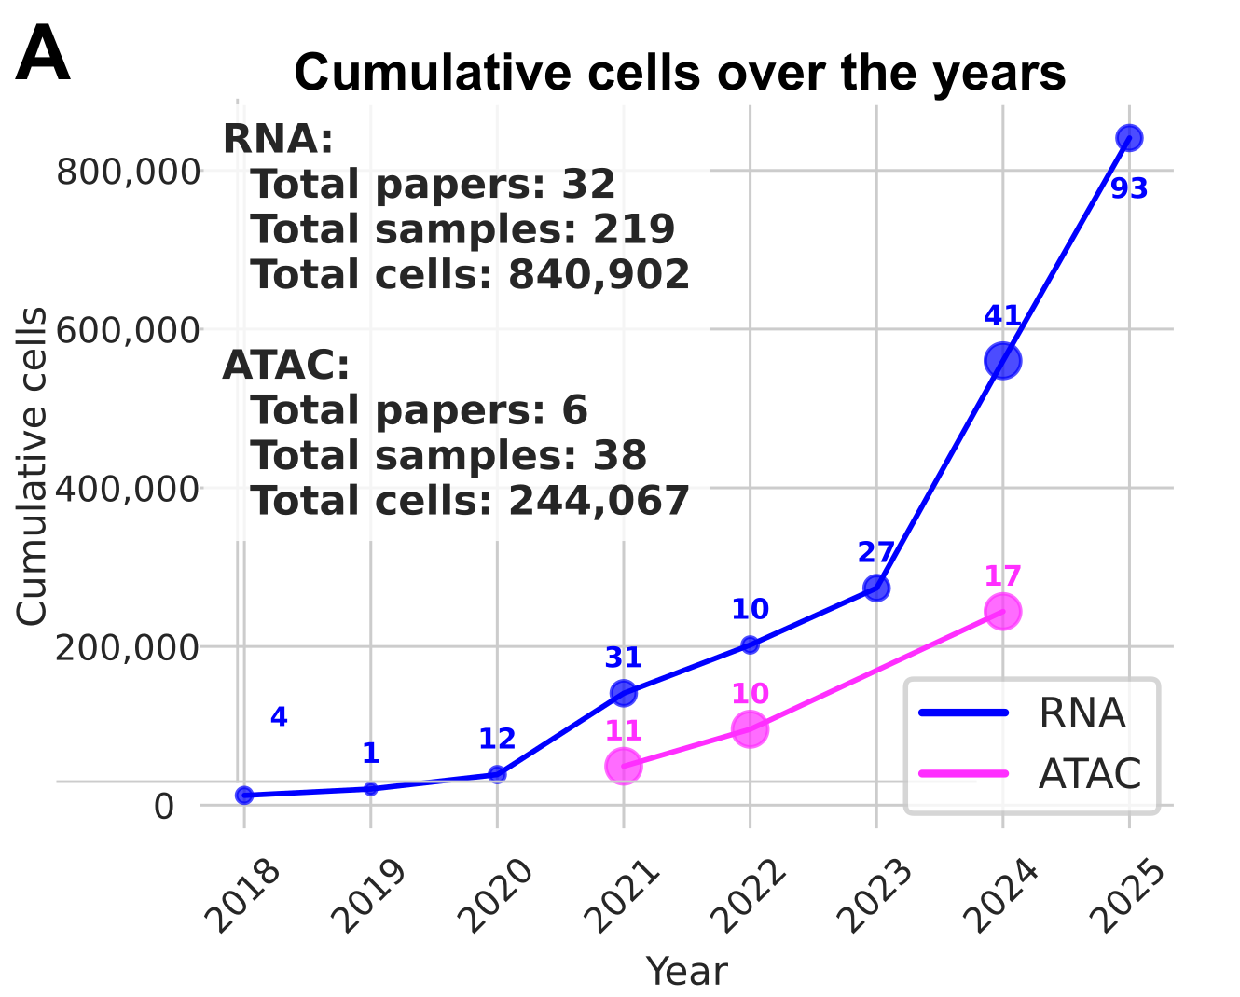
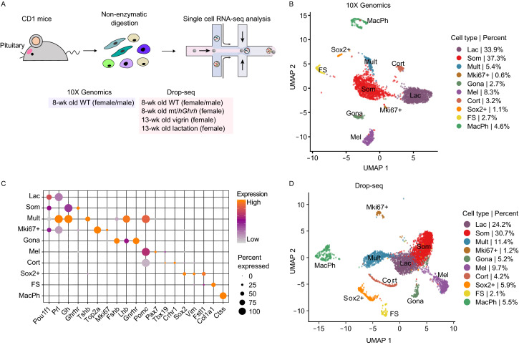
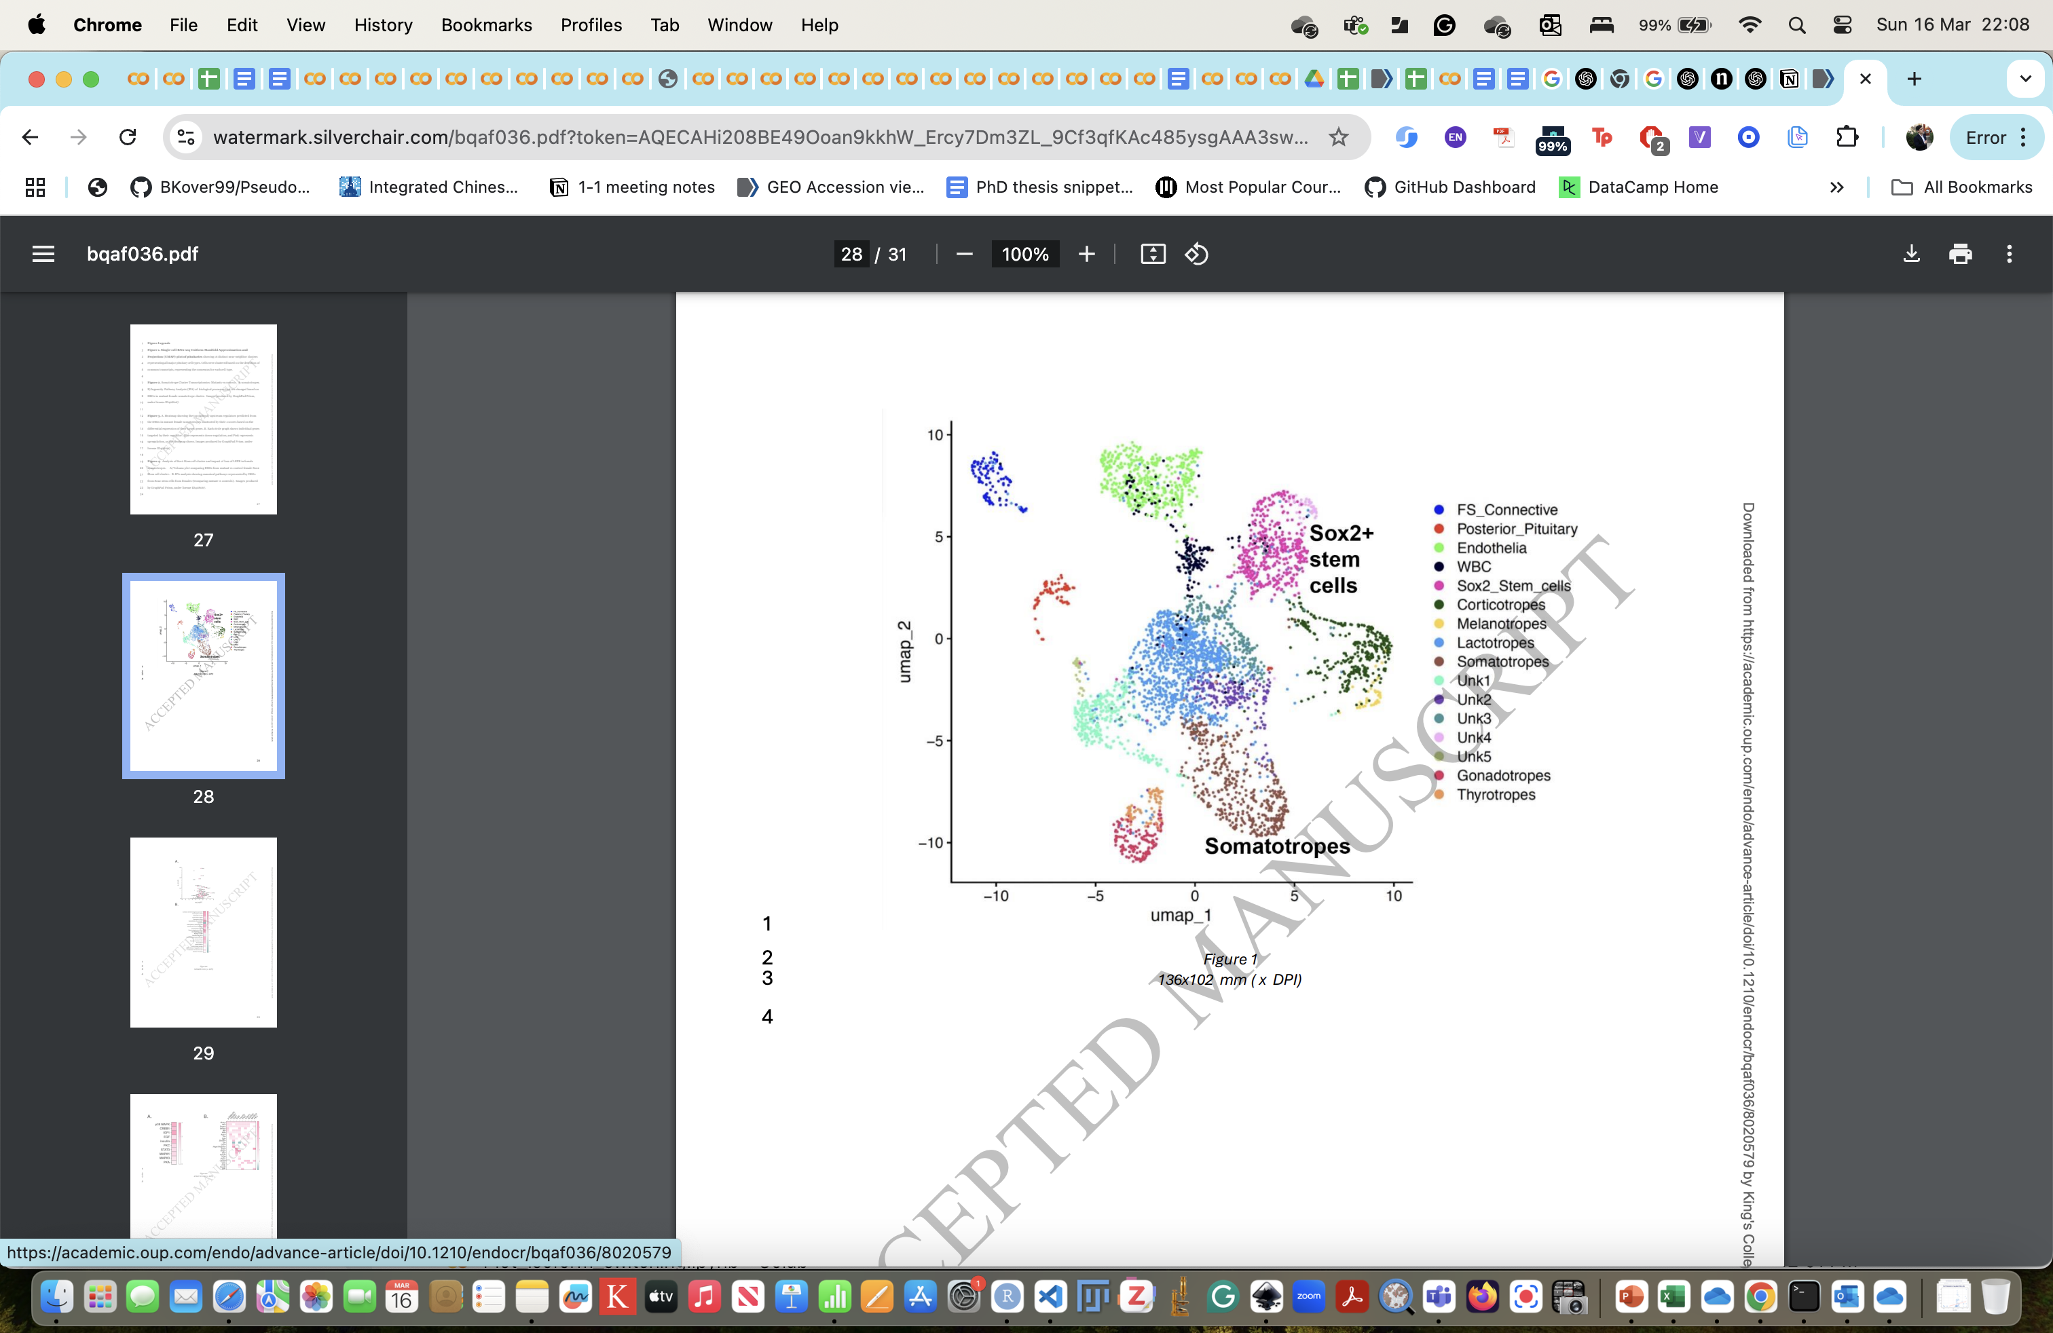
Exponential adoption of single-cell profiling, but…
Li et al. (2023)
Ho et al. (2020)
Kover et al. (Unpublished)
Minimal insights
Irreproducible results
A shared framework is needed
Miles et al. (2025)

Slide 4

The shared framework: a uniformly pre-processed Consensus Pituitary Atlas
Kover et al. (Unpublished)

Slide 5
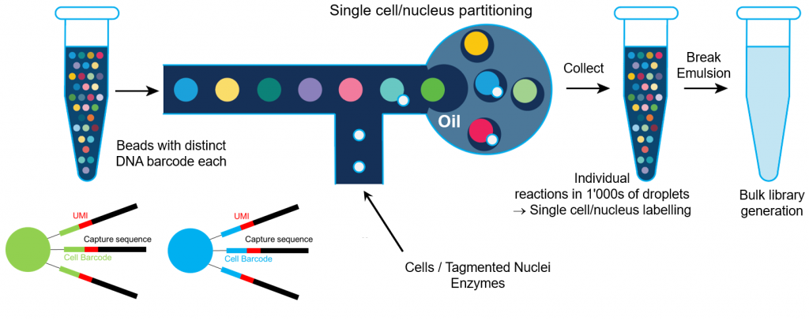
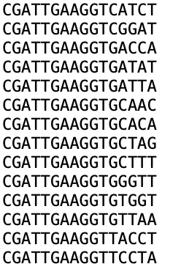
Peer-reviewed publications contain incorrect metadata – 10X barcodes
Some barcodes from the 10XV2 whitelist
Source: https://wp.unil.ch/gtf/single-cell-experiments-10x/
Problem:
Each “chemistry” or barcoding kit has a set of allowed cell barcodes (“whitelist”)
Most experiments are done using 10x v2 or v3 chemistry.
Unfortunately, authors copy “Methods” across papers, and thereby report incorrect chemistry
Solution: Compare R1 reads to possible whitelists, and reverse-engineer what the authors actually used.

Slide 6
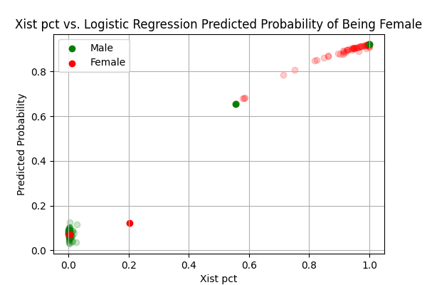
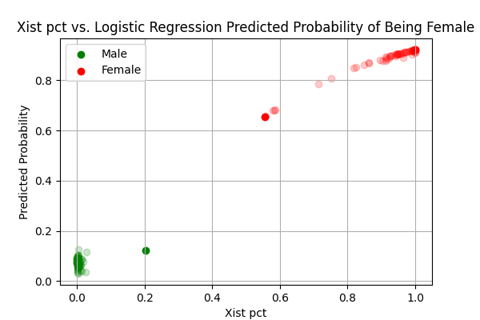
Peer-reviewed publications contain incorrect metadata – sex of the animals
Problem:
Some papers or their GEO/SRA accessions have missing or incorrect information on sex
Solution:
Using the known sex labels, applied a simple logistic regression model using sex-linked genes (Xist, Tsix, Ddx3y), to predict unknowns and flag outliers.
Turns out one paper had incorrect sexes for two samples. Alarmingly, this paper studied the sex-specific effects of high-fat diet… (Miles et al. 2023)
Original labels
Corrected labels
Kover et al. (Unpublished)

Slide 7
It’s neither single-cell nor RNA-seq
Good
Bad
Droplet
Doublet
No bead
Cell
RNA
Bead
Ambient RNA
Irrelevant
Barcode collision
> 1 bead
Inspired by slide from Lior Pachter’s Bi/BE/CS 183 Lecture 2, 2021-2022

Slide 8
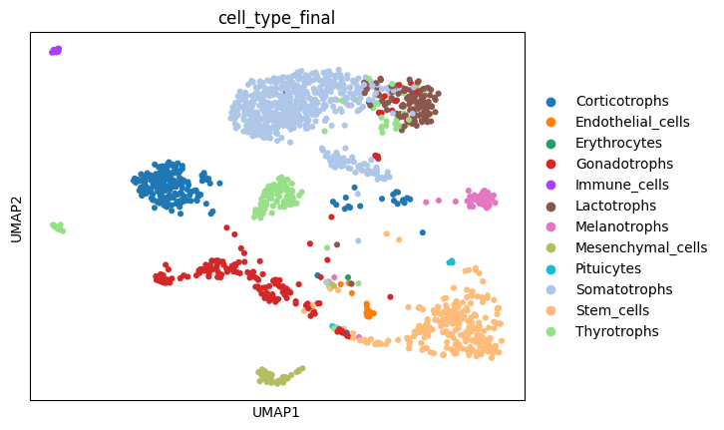
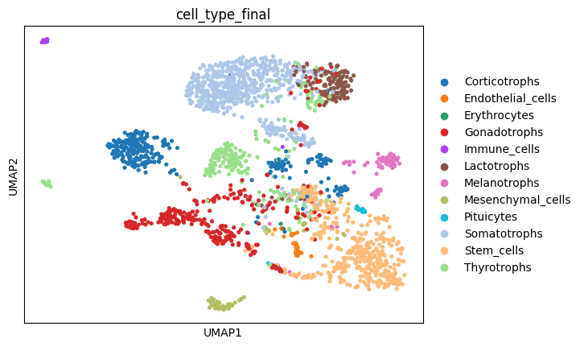
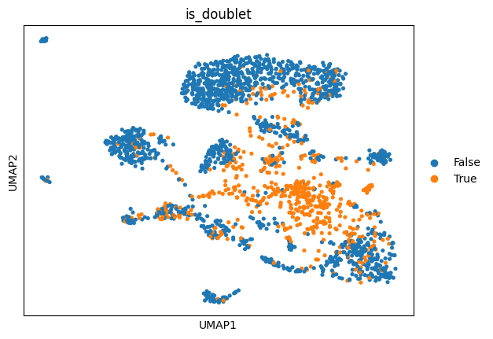
Main problems: Doublets and Ambient RNA
Doublets…
Doublets:
“Multihormonal cells”? or “a new cell type”? – No, just technical artefact
Solution:
Initial doublet filtering using generalistic algorithms (e.g., scrublet)
We also trained a gradient boosting algorithm on simulated doublets vs real cells, and we can now tell these apart with near 100% accuracy. This will be applied on future datasets.
Doublet
Ho et al. (2020)
Ambient RNA:
Top contaminating transcripts are almost entirely hormones!
Again, “Multihormonal cells”? “Low-level hormone expression”? – No, just technical artefact
Solution:
We used scAR, a variational autoencoder that jointly models RNA abundance in real-cells and cell-free droplets (these should be 100% ambient RNA).
RNA
Ambient RNA

Slide 9
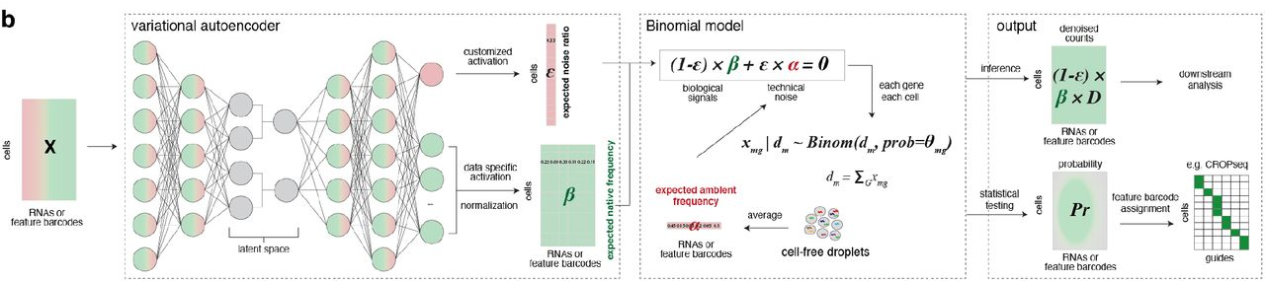
scAR removes hormone contamination across cell types
Sheng et al. (2022)
Before: Hormones are all over the place!
scAR is a good generative model for inferring true counts. But for 99% of the genes the observed counts are more accurate/relevant.
We only used the scAR corrected counts on the top 200 contaminating genes (as determined from cell-free droplets).
After: Hormones are all cleaned up!
Kover et al. (Unpublished)

Slide 10
Per-dataset quality control rather than just global hard cut-offs
Problem:
Each dataset is sequenced to different depth and has variable quality
There are lots of datasets, need to automate filtering
Solution:
Use a per-dataset filtering strategy AND a global cut-off across datasets
A good strategy: median +/- x* median absolute deviation (x ranging from 3-5 for various metrics)
Example dataset 1
Example dataset 2
Kover et al. (Unpublished)
Global
Specific
Global
Global
Specific
Global
Specific
Specific
Specific
Specific
Specific
Specific
Specific
Specific
Specific
Specific
Specific
Specific
Specific
Specific
Specific
Specific

Slide 11
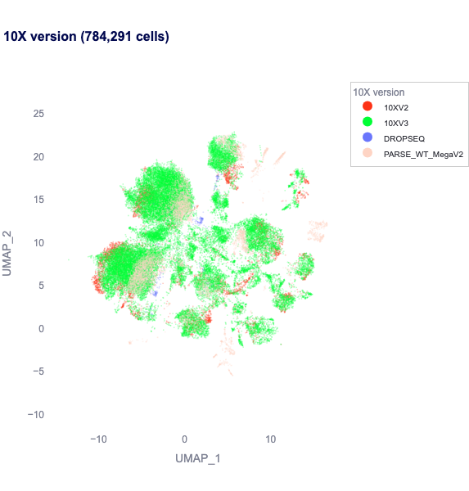
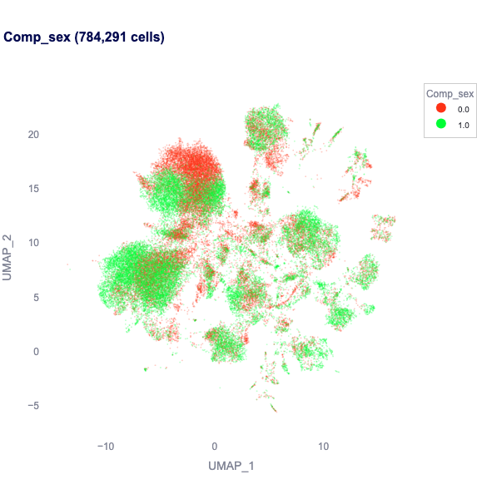
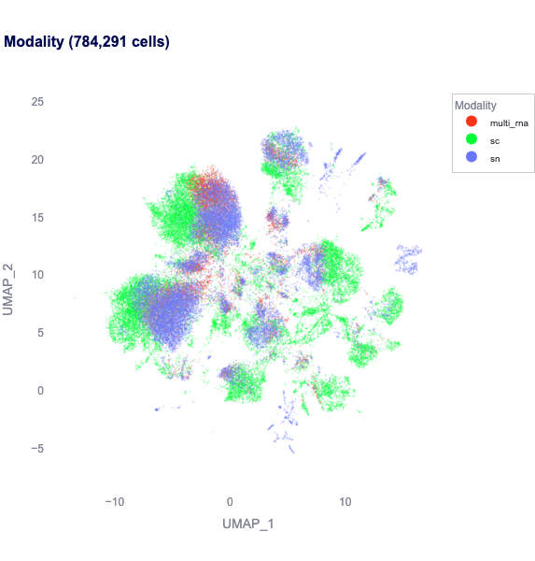
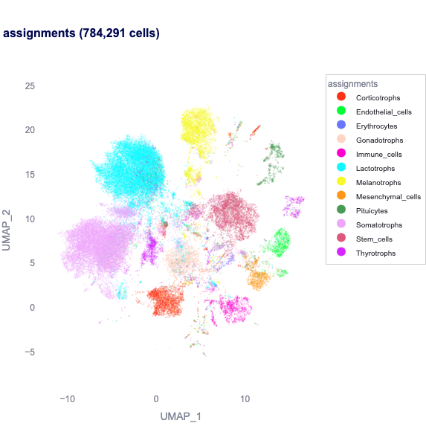
“Integration” of single-cell datasets
Problem:
Studies differ in many factors:
Single-cell technology
Dissociation protocols
Mouse facility, mouse background
Various other sources of noise
It would be good to account for these and homogenize datasets
We have 260 samples and >1M cells…
Solution:
We used the variational autoencoder framework scVI (Lopez et al., 2018)
Continous covariates:
Percentage of mitochondrial, ribosomal and intronic counts
Age
Categorical covariates:
Sex
scVI latent space with homogenized covariates
Assay chemistry
Sex
Assay modality
Cell types
Kover et al. (Unpublished)

Slide 12
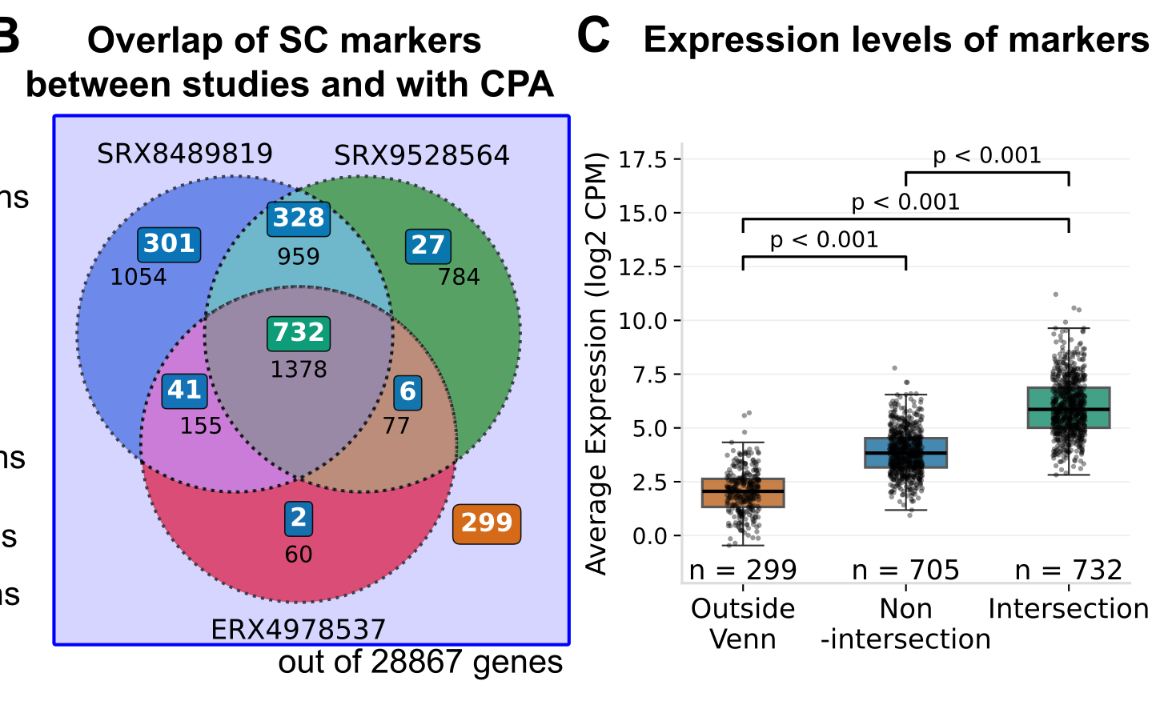
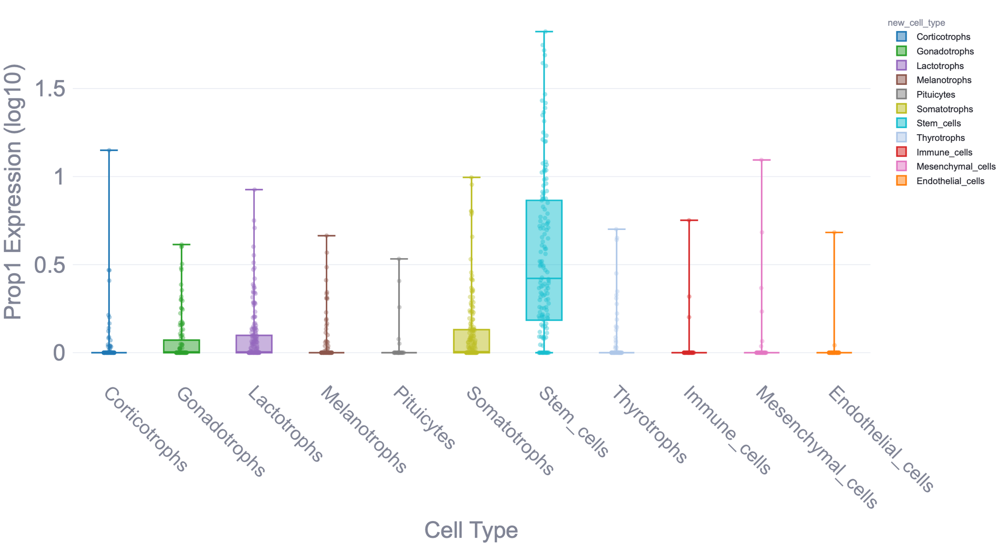
What is a biological replicate? - Pseudobulk > Single-cell
People typically use Wilcoxon test using 10000s of cells, reaching astronomical P-values...
And lots of false positives and false negatives!
Large body of work now shows that differential expression should be done at the pseudobulk-level!
(Murphy & Skene, 2022; Mukamel & Yu, 2025; Thurman et al., 2021; and many others)
Pseudobulk analysis increases reproducibility and enriches for novel low-expression markers!
Prop1: Known key pituitary stem cell TF!
299 novel low-expression stem cell markers!
Kover et al. (Unpublished)

Slide 13
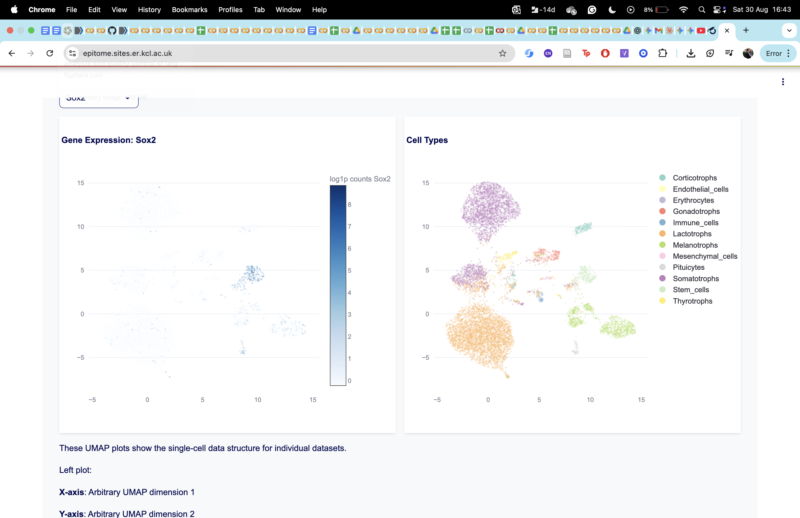
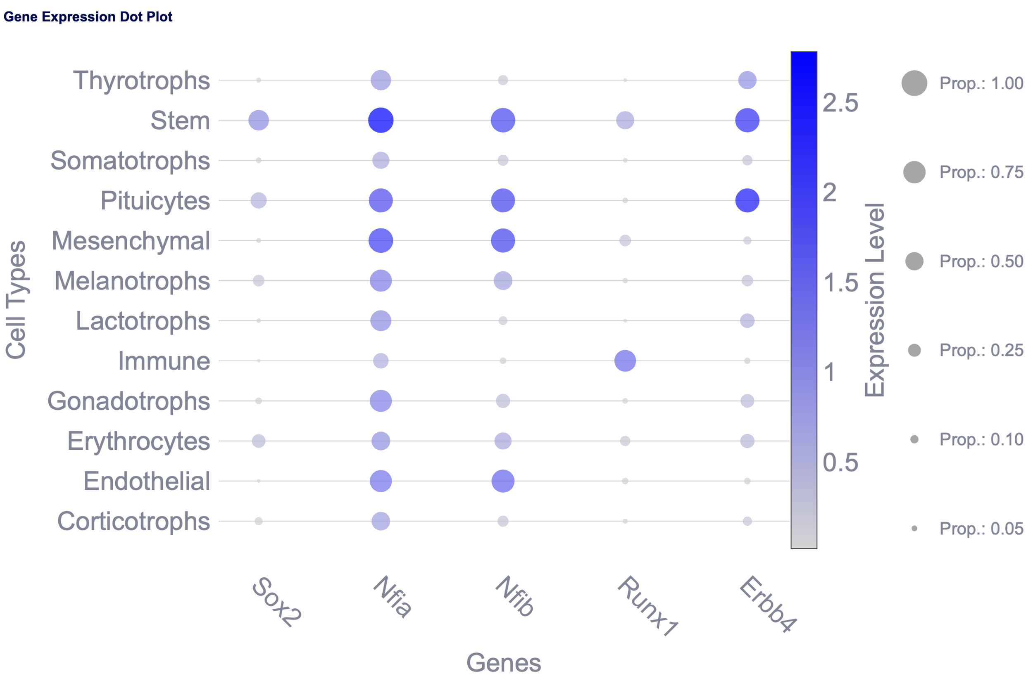
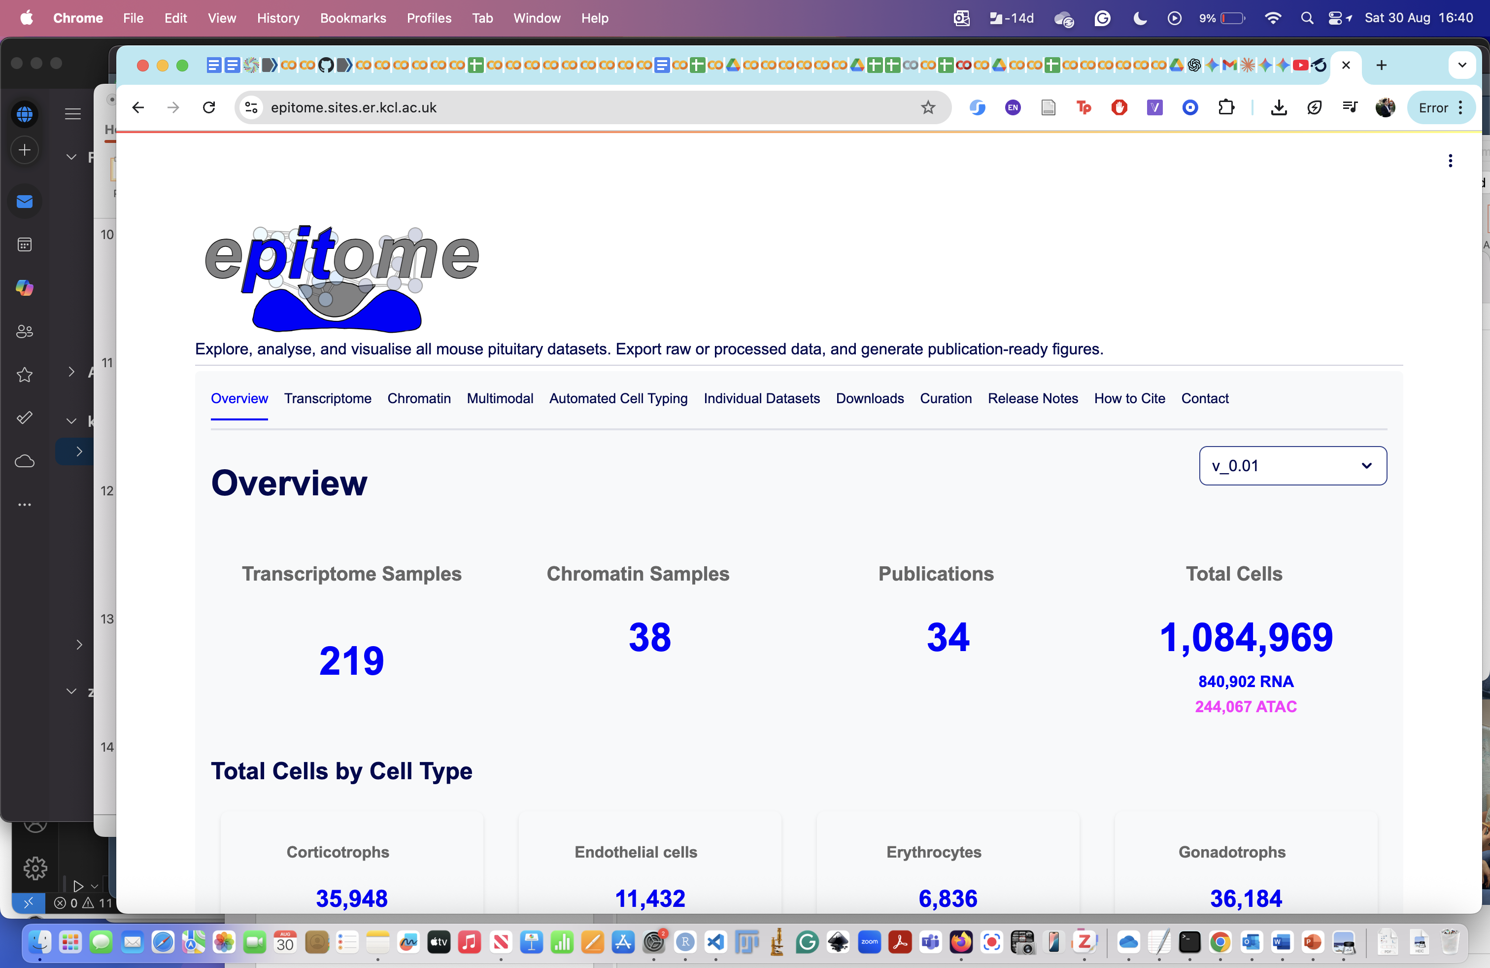
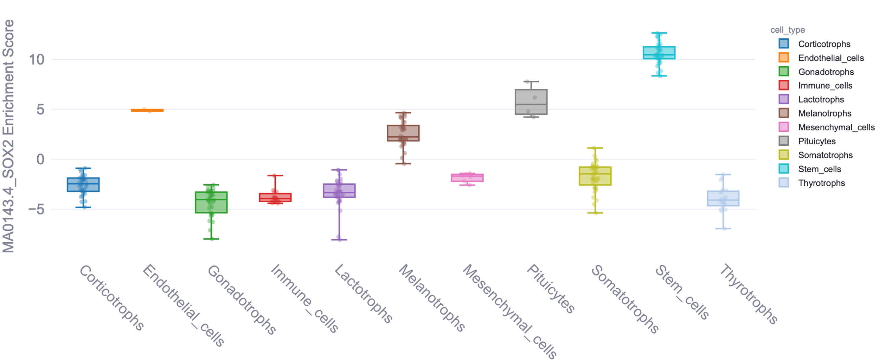
Communicating results
People often just share table of marker genes in the supplement
At best, you can browse some UMAPs online
This is not acceptable, and makes reproducibility difficult
We generated the electronic pituitary omics resource (epitome)
Kover et al. (Unpublished)

Slide 14



Brief summary of biological insights
Novel markers that individual datasets were blind to
3700 instance of sex-biased gene expression at the cell type level
12000 instances of age-dependent gene expression
Novel drivers of cell fate, shared across modalities (RNA, ATAC)
Main takeaways
There has been an explosion in using single-cell techniques, but insights have been lagging behind
Peer-reviewed publications are not perfect
Methods matter – running your data through a Seurat tutorial won’t cut it
Slides available on:
github.com/BKover99/talk_slides
bsky.app/profile/bencekover.bsky.social
linkedin.com/in/ben-kover/

Slide 15
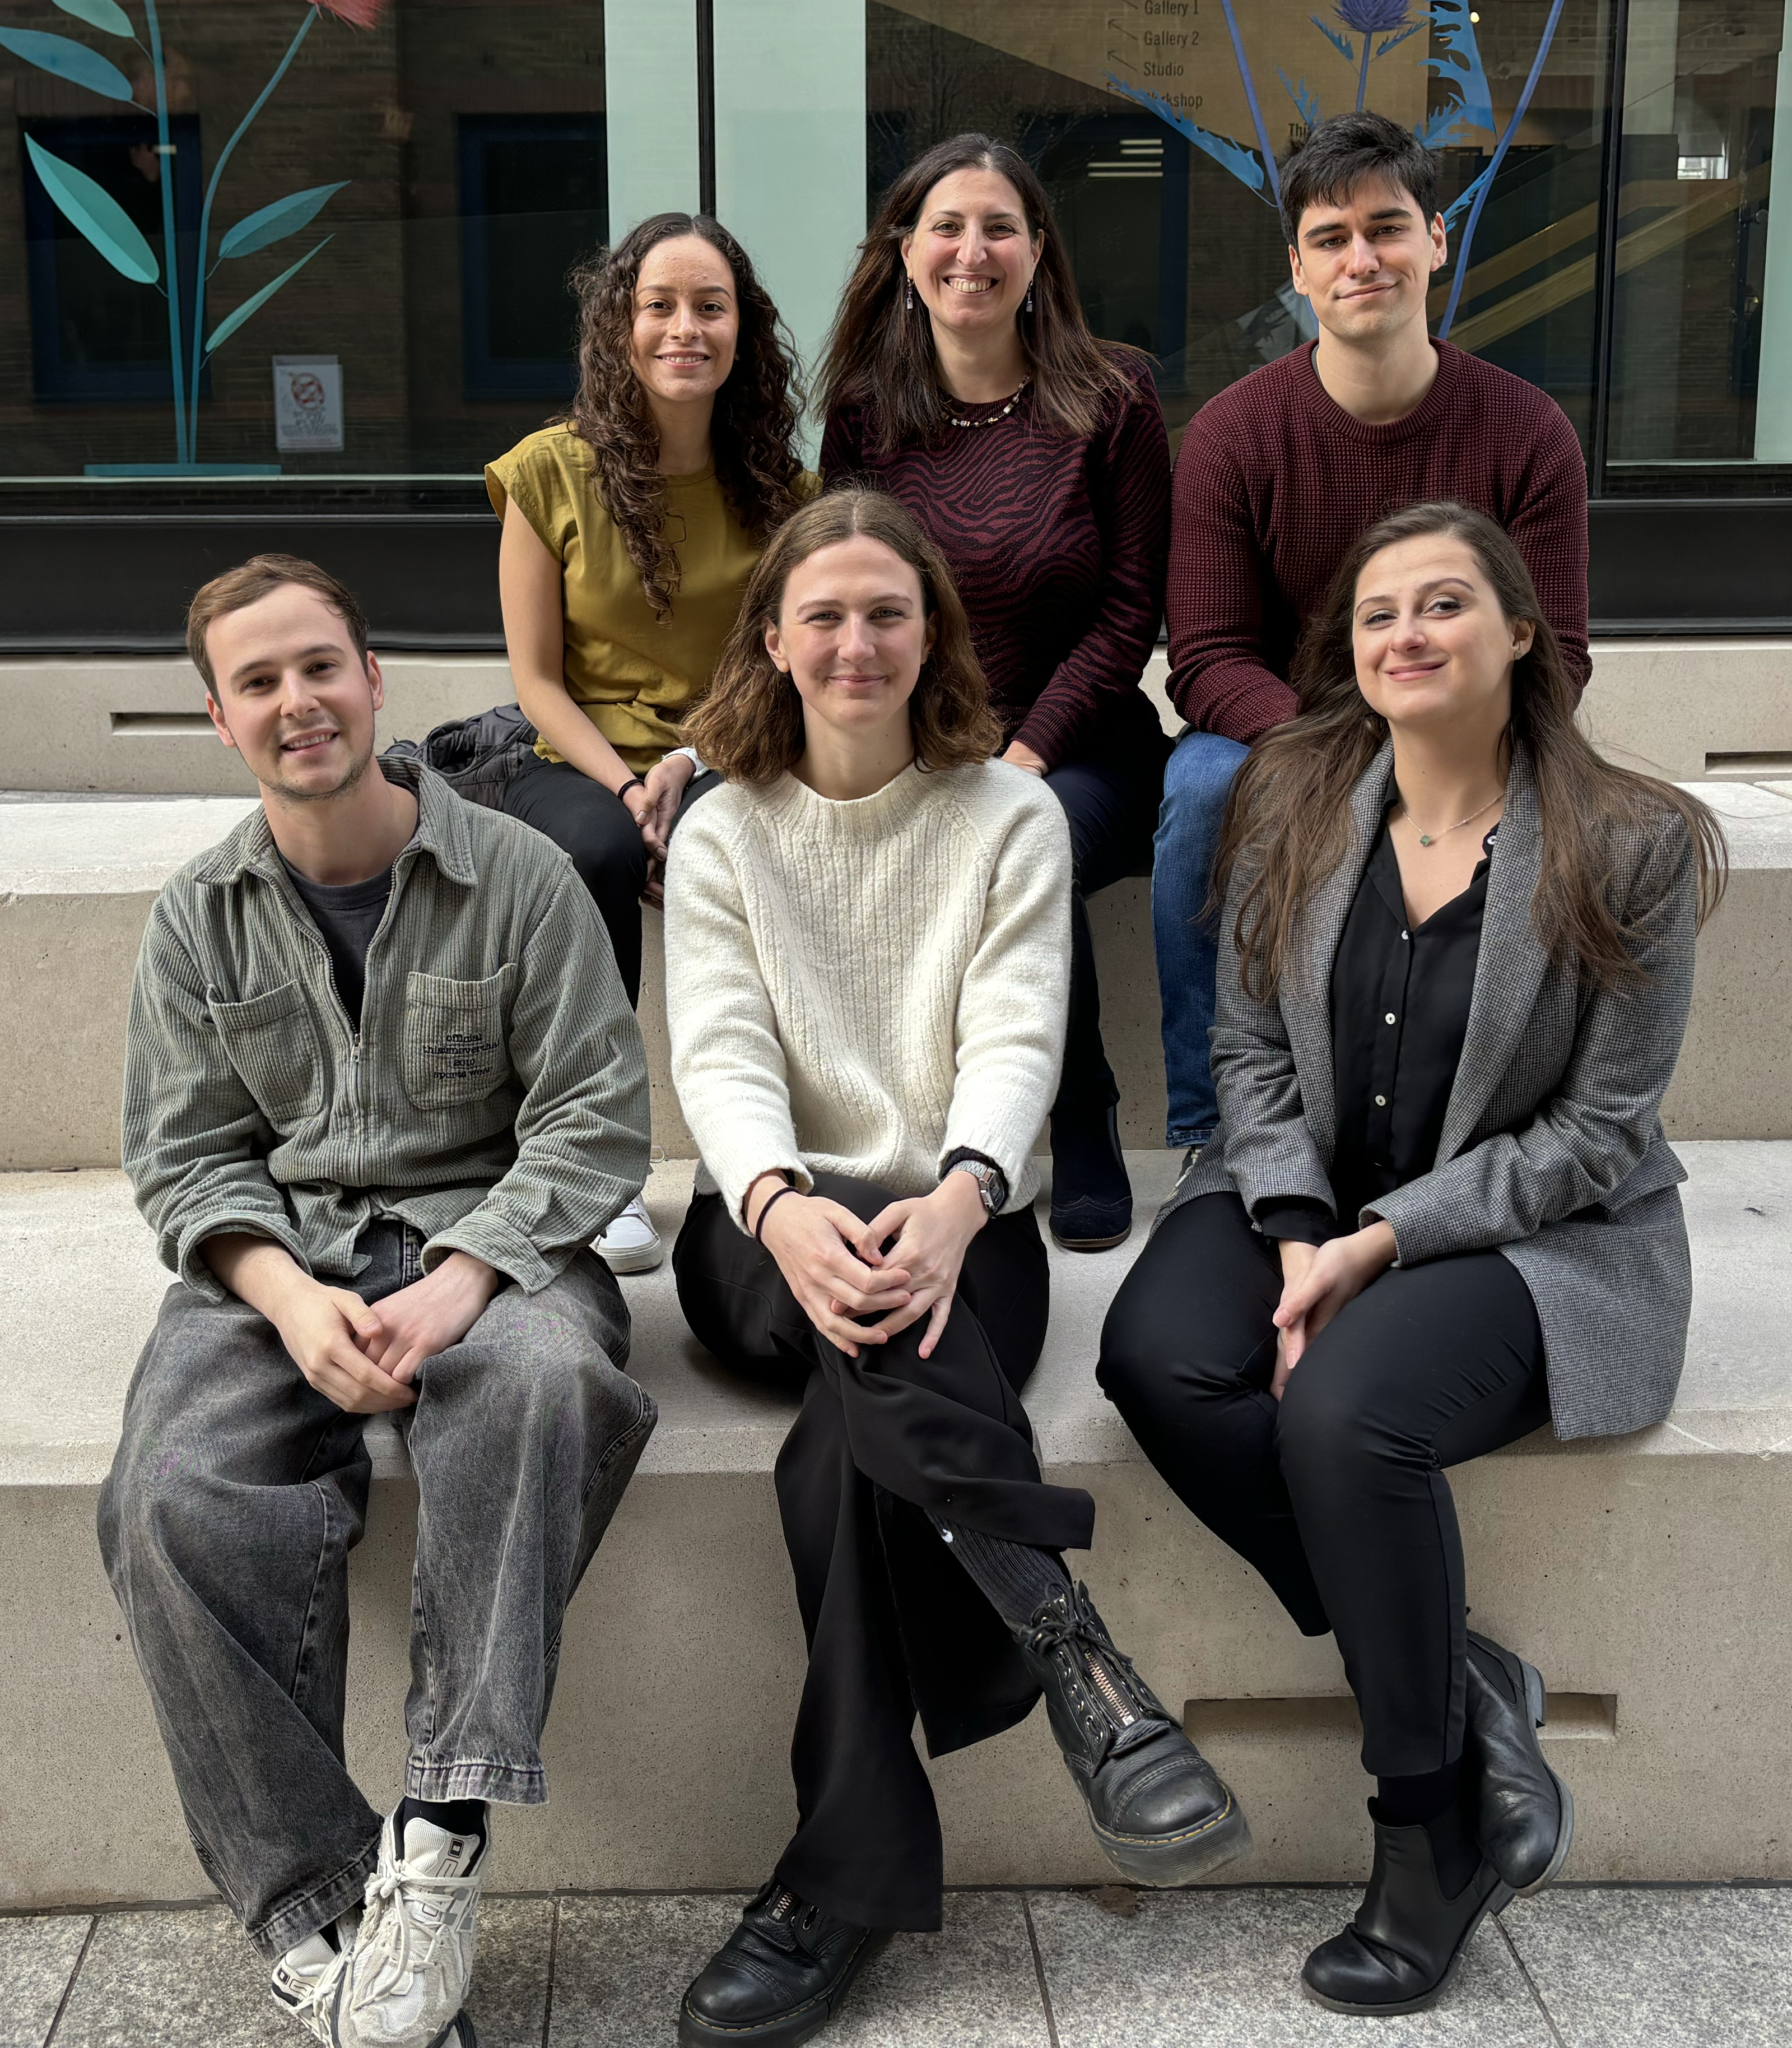
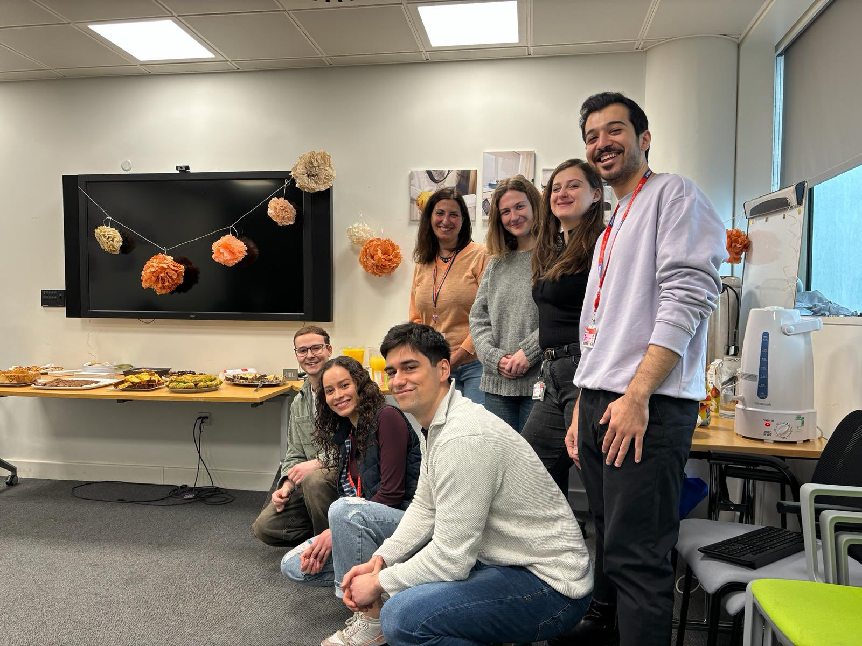

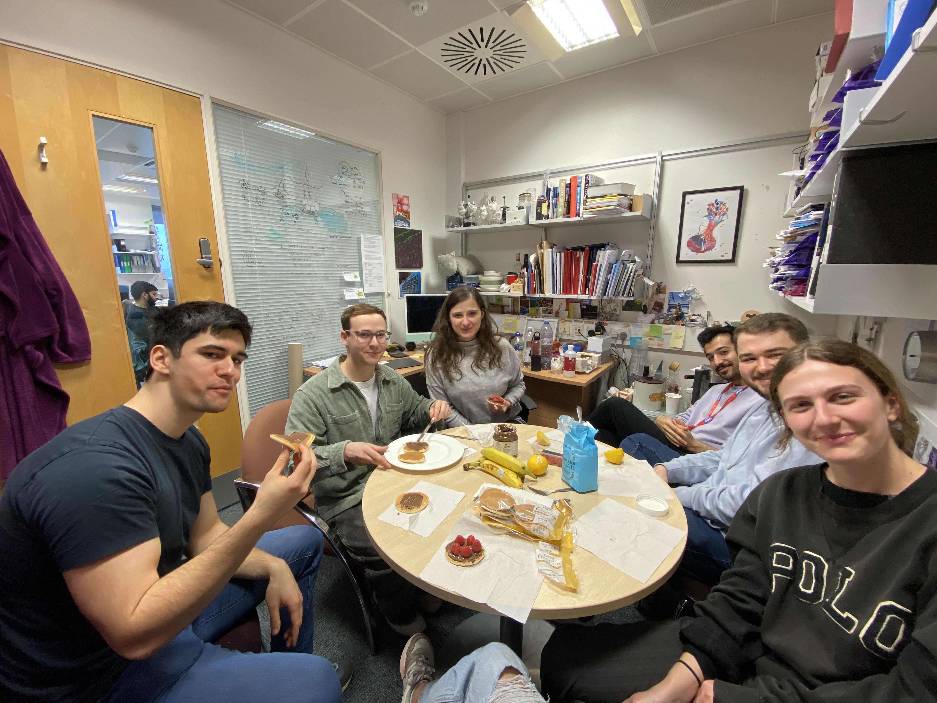
Acknowledgements
Supervision:
Prof. Cynthia Andoniadou
Dr Hui-Chun (Grace) Lu
Andoniadou lab:
Miriam Vazquez Segoviano
James Kaufman-Cook
Olivia Sherwin
Dr Yasmine Kemkem
Dylan Cameron
Sofiat Onafuwa
Dr Mark Quinn
Ian Kruk
King’s e-Research:
Zsolt Balla
Feedback on epitome:
Prof. Dan Bernard (McGill, Canada)
Dr Frederique Ruf-Zamojski (Cedars-Sinai, USA)
Thesis Committee:
Dr Rocio Sancho
Prof. Agi Grigoriadis
Funding: Advanced Therapies for Regenerative Medicine Wellcome Trust PhD Programme (218461/Z/19/Z)

Slide 16
References in order of appearance
Pérez Millán MI, Cheung LYM, Mercogliano F, Camilletti MA, Chirino Felker GT, Moro LN, et al. Pituitary stem cells: past, present and future perspectives. Nat Rev Endocrinol. 2024 Feb;20(2):77–92.
Kim SY. Diagnosis and Treatment of Hypopituitarism. Endocrinol Metab. 2015 Dec 31;30(4):443–55.
Martinez-Mayer J, Vishnopolska S, Perticarari C, Iglesias Garcia L, Hackbartt M, Martinez M, et al. Exome Sequencing Has a High Diagnostic Rate in Sporadic Congenital Hypopituitarism and Reveals Novel Candidate Genes. J Clin Endocrinol Metab. 2024 Dec 1;109(12):3196–210.
Daly AF, Beckers A. The Epidemiology of Pituitary Adenomas. Endocrinol Metab Clin North Am. 2020 Sept;49(3):347–55.
Melmed S, Kaiser UB, Lopes MB, Bertherat J, Syro LV, Raverot G, et al. Clinical Biology of the Pituitary Adenoma. Endocr Rev. 2022 Dec 1;43(6):1003–37.
Miles TK, Odle AK, Byrum SD, Lagasse AN, Haney AC, Ortega VG, et al. Ablation of Leptin Receptor Signaling Alters Somatotrope Transcriptome Maturation in Female Mice. Endocrinology. 2025 Feb 18;bqaf036.
Ho Y, Hu P, Peel MT, Chen S, Camara PG, Epstein DJ, et al. Single-cell transcriptomic analysis of adult mouse pituitary reveals sexual dimorphism and physiologic demand-induced cellular plasticity. Protein Cell. 2020 Aug;11(8):565–83.
Li Y, Wang J, Wang R, Chang Y, Wang X. Gut bacteria induce IgA expression in pituitary hormone-secreting cells during aging. iScience. 2023 Oct 20;26(10):107747.
Miles TK, Odle AK, Byrum SD, Lagasse A, Haney A, Ortega VG, et al. Anterior Pituitary Transcriptomics Following a High-Fat Diet: Impact of Oxidative Stress on Cell Metabolism. Endocrinology. 2023 Dec 23;165(2):bqad191.
Lopez R, Regier J, Cole MB, Jordan MI, Yosef N. Deep generative modeling for single-cell transcriptomics. Nat Methods. 2018 Dec;15(12):1053–8.
https://github.com/pachterlab/Bi-BE-CS-183-2022
Sheng C, Lopes R, Li G, Schuierer S, Waldt A, Cuttat R, et al. Probabilistic machine learning ensures accurate ambient denoising in droplet-based single-cell omics [Internet]. bioRxiv; 2022 [cited 2024 July 18]. p. 2022.01.14.476312. Available from: https://www.biorxiv.org/content/10.1101/2022.01.14.476312v4
Mukamel EA, Yu Z. False positives in study of memory-related gene expression. Nature. 2025 June;642(8066):E1–3.

